Slide 1

Notes:
Music as Sammy enters and welcomes guests. House keeping – colors on name plate, restrooms, Twitter, headshot reminder
Introduce Jessica as our Executive Sponsor

Slide 2


Engage with us on Twitter!
#AgCRise
There will be a prize given for the Tweet that generates the most Likes, Comments, and Retweets

Slide 3
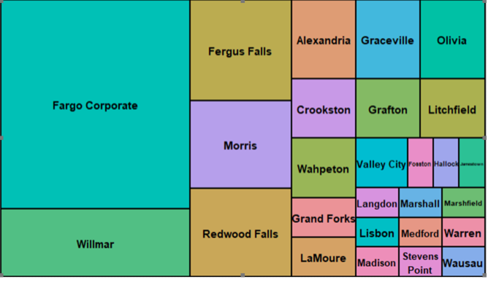

Who’s Here?

Slide 4
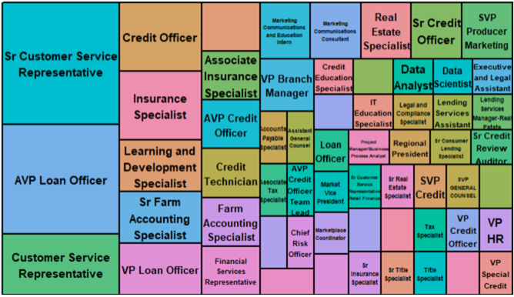

Who’s Here?

Slide 5
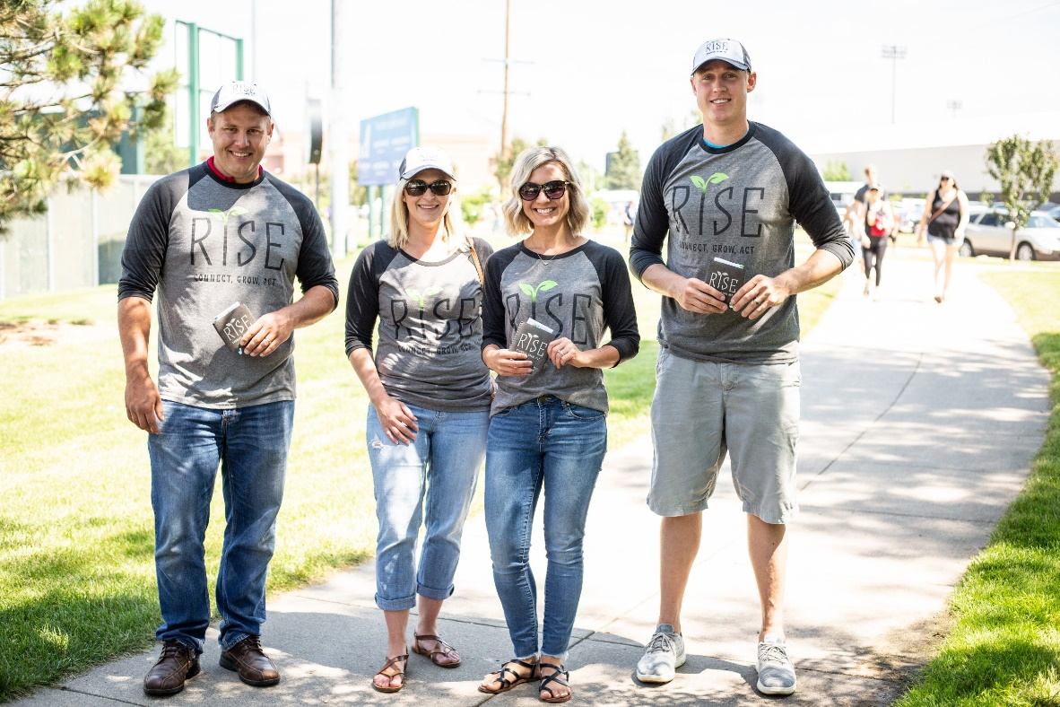
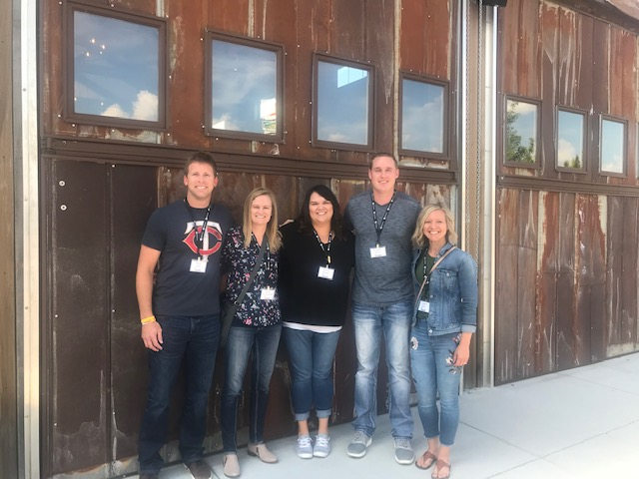
What is Rise?
Notes:
Jessica – Mission & Vision of Rise
Introduce Rise Leadership Team
Team goes up front as introduced

Slide 6
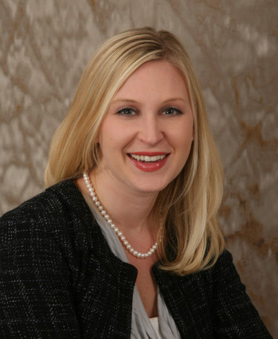
Jessica Fyre
Rise Executive Sponsor
SVP General Counsel
Favorite Quote: Today is the oldest you’ve ever been, and the youngest you’ll ever be again. - Eleanor Roosevelt

Slide 7

Notes:
Jessica – Mission & Vision of Rise
Introduce Rise Leadership Team
Team goes up front as introduced

Slide 8
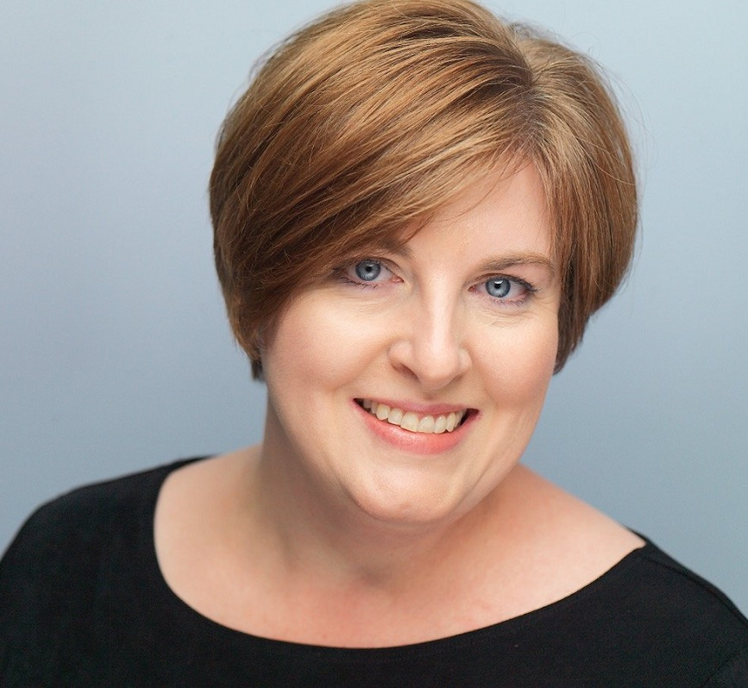
Robin Smith-Masog
Rise Team Advisor
VP Organizational Development
Favorite Quote: When you learn, teach. When you get, give. - Maya Angelou

Slide 9
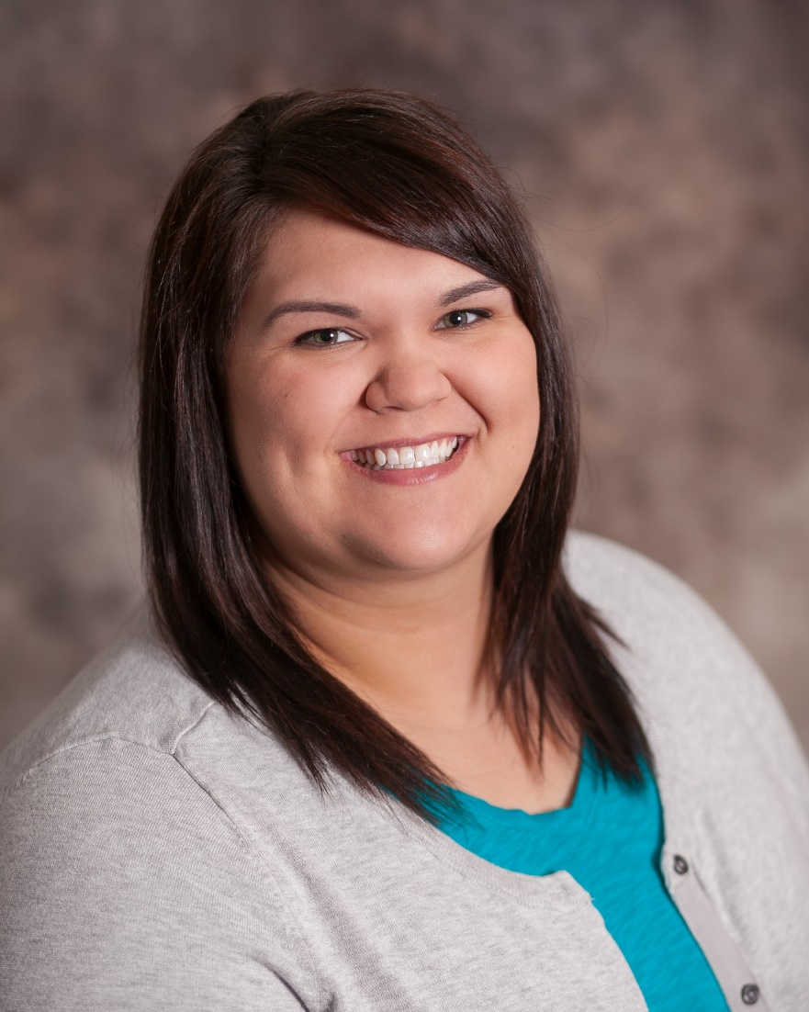
Sammy Baxter
Insurance Specialist
Graceville, MN
Favorite Quote: It is our choices that show what we truly are, far more than our abilities. - J. K Rowling

Slide 10
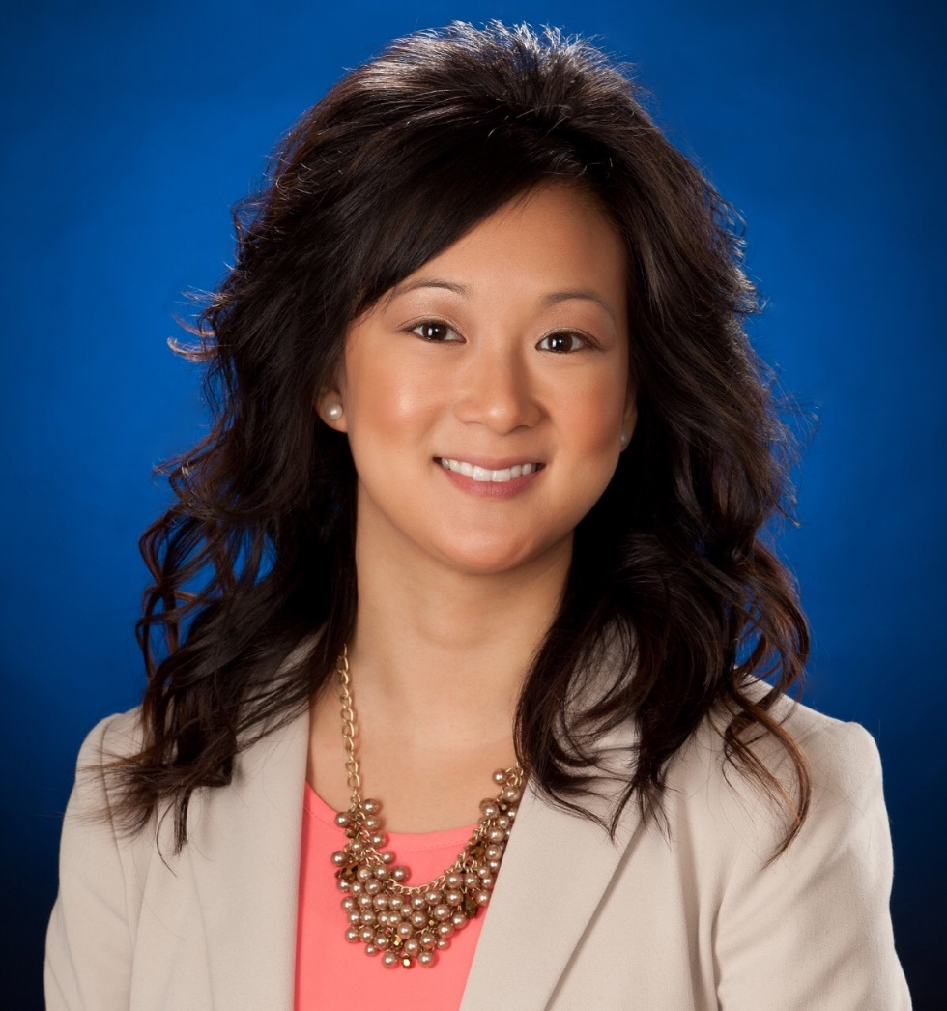
Natalie Cameron
Sr. Financial Analyst
Grafton, ND
Fun Fact: I am a Certified Public Accountant, but I decided to pursue a career more centered in financial analysis than public accounting.

Slide 11
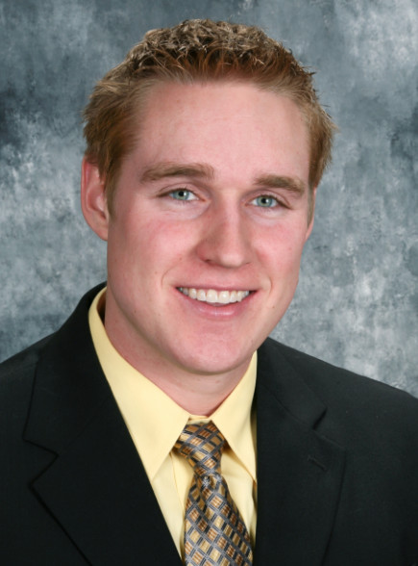
Brendon Foss
AVP Loan Officer
Morris/Alexandria, MN
Fun Fact: My wife and I are expecting our first child in March 2020! Hello sleepless nights….

Slide 12
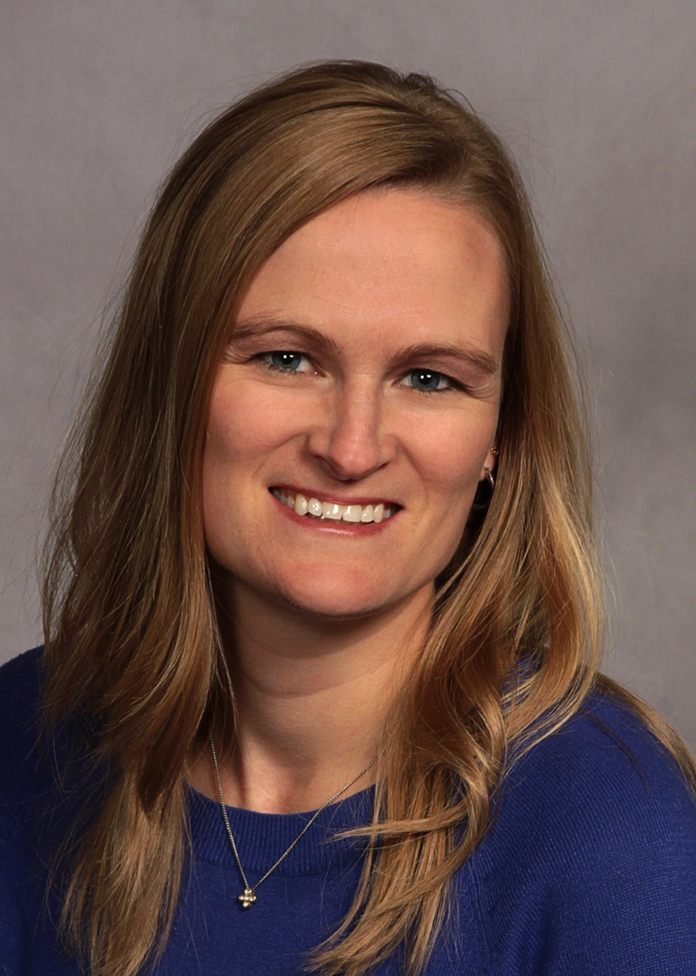
Becky Huhnerkoch
AVP Credit Officer
Redwood Falls, MN
Fun Fact: I love science fiction books.

Slide 13
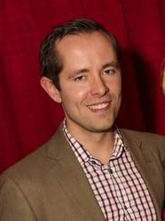
Brad Lindblad
Data Scientist
Fargo, ND
Fun Fact: I run a beet farm/bed and breakfast.

Slide 14
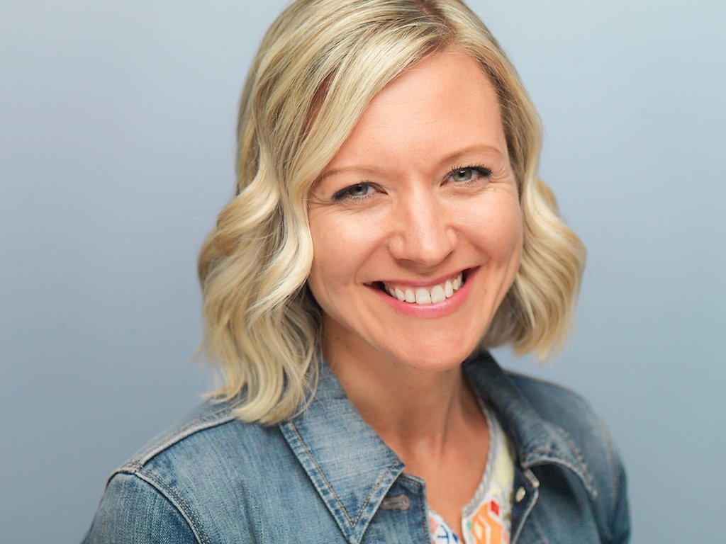
Andrea Olson
Learning and Development Specialist
Fargo, ND
Favorite Quote: I never lose, I either win or learn. - Nelson Mandela

Slide 15
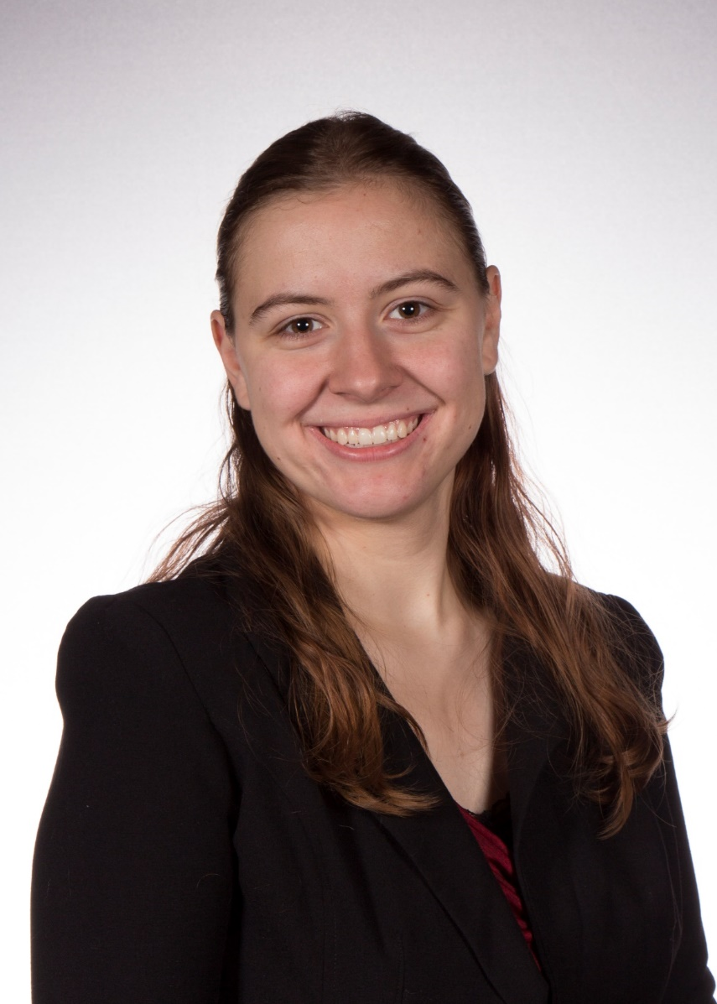
Jade Pinter
Customer Service Representative
Medford, WI
Fun Fact: I like my cows so much that I brought them on my vacation.

Slide 16
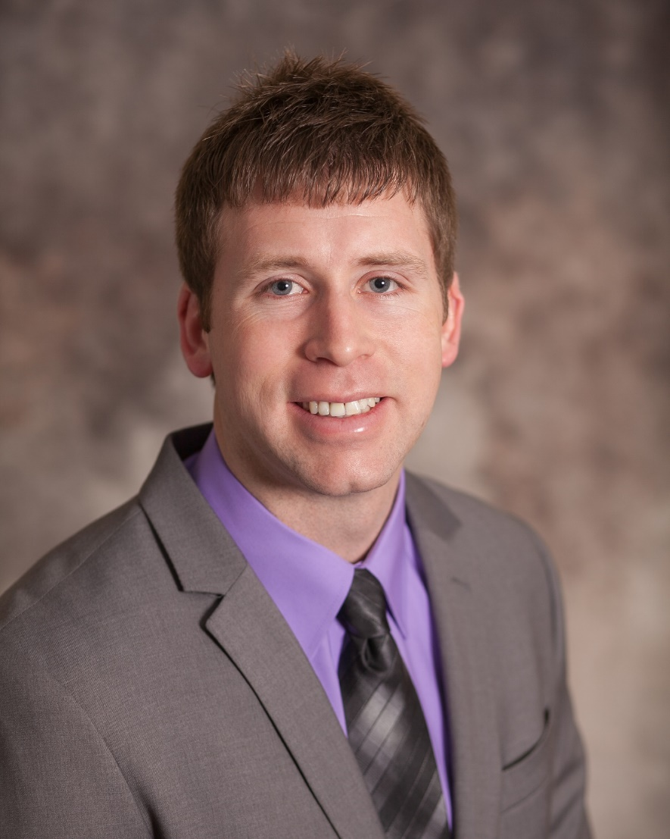
Brady Rose
AVP Loan Officer
Graceville, MN
Favorite Quote: Don’t wait for opportunity, create it! - Debasish Mridha

Slide 17
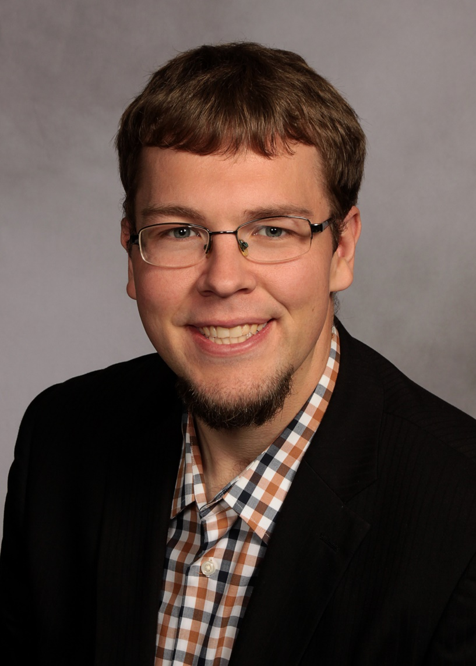
Adam Ulbricht
Marketing Communications Consultant
Willmar, MN
Fun Fact: I once sang the song “Baby Got Back” by Sir Mix-A-Lot on live Polish radio.

Slide 18
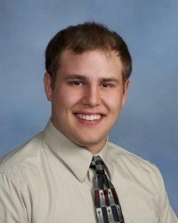
Mark Vetter
Market Vice President
LaMoure, ND
Fun Fact: In my spare time I like to hunt, fish and garden.

Slide 19
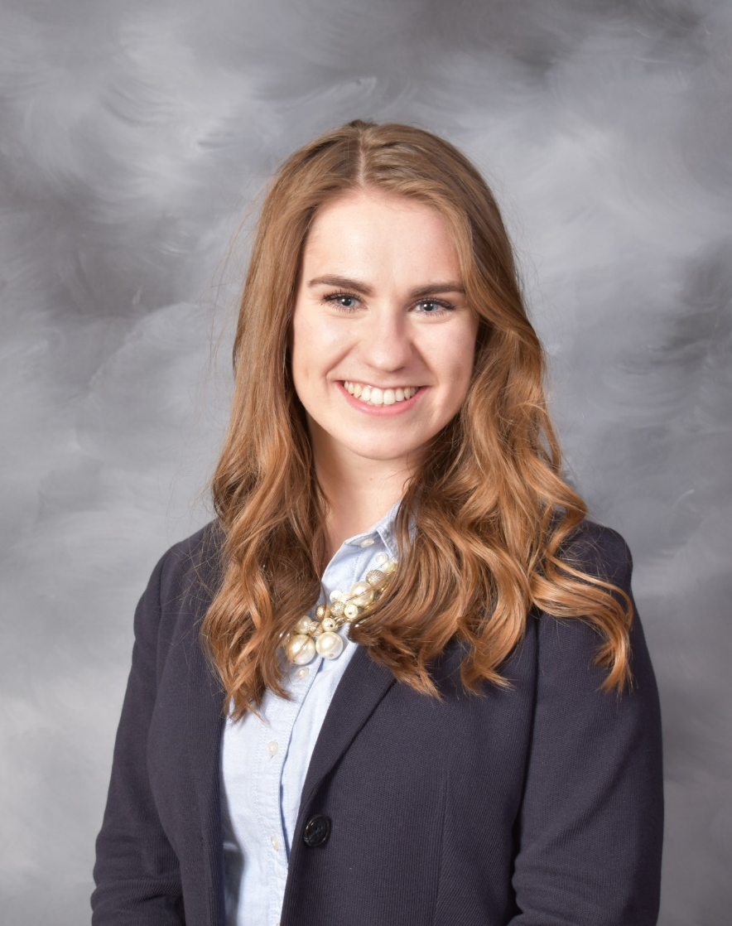
Anna Lemm
Marketing Communications and Education Intern
Fargo, ND
Fun Fact: Anna was recently crowned NDSU Homecoming Queen.

Slide 20
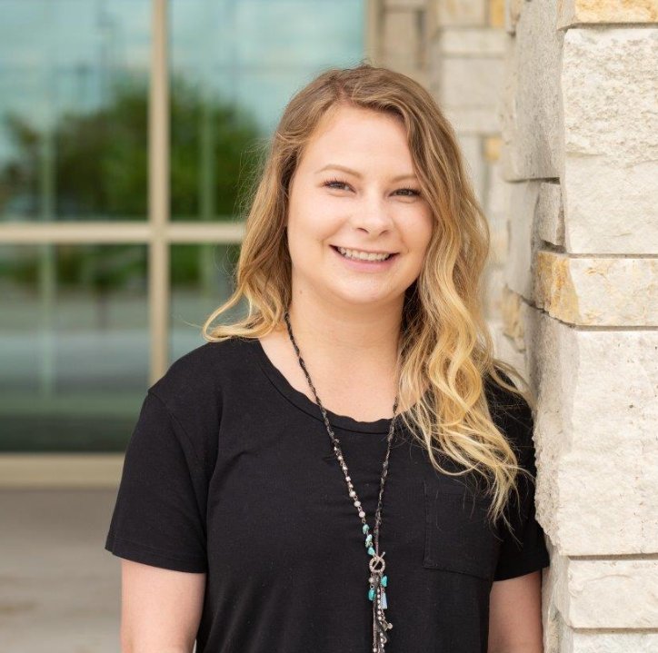
Kendra Neu
Marketing and Education Intern
Fargo, ND
Fun Fact: Kendra has traveled to South Africa.

Slide 21

People BINGO
Be the first to get a BLACKOUT & Ding the Bell to win!
Notes:
Natalie & Andrea to introduce
Music playing during activity

Slide 22
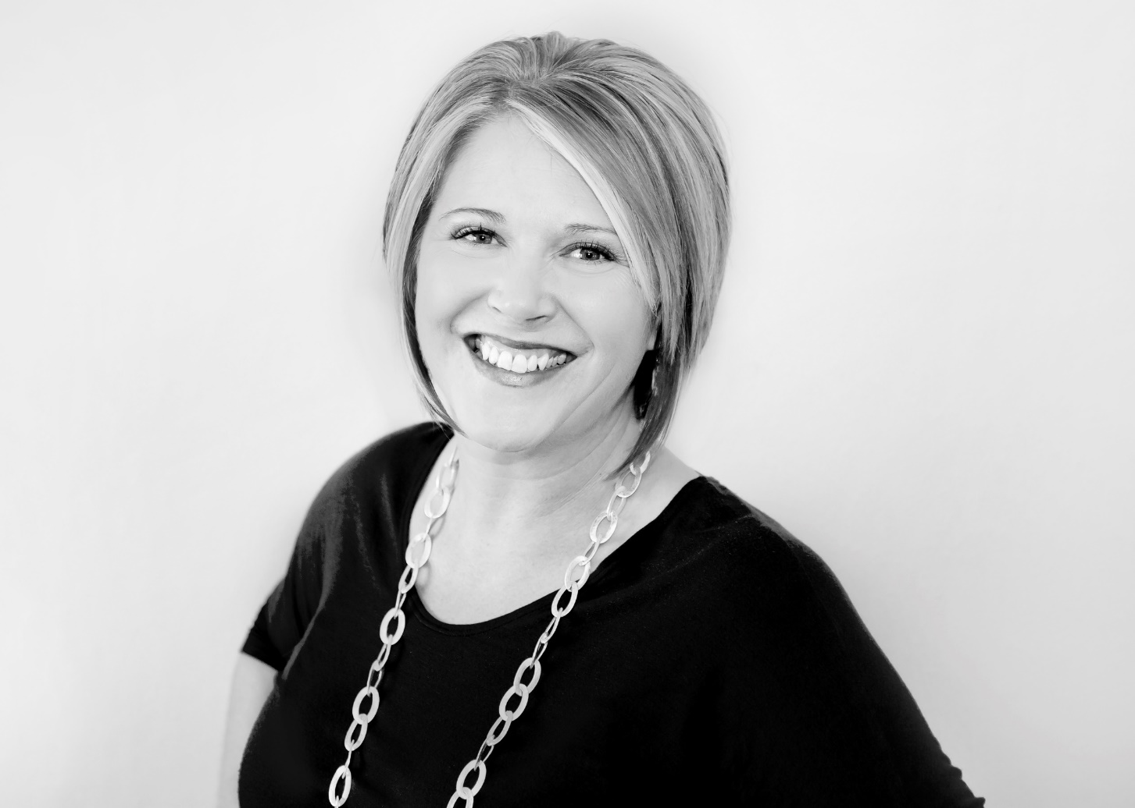
Missy Ohe
Notes:
Becky to introduce

Slide 23




What Bus are You Riding?
The color on the back of your name plate represents what bus you will ride!
Buses Will Load @ 12:45

